Slide 1






Web Fundamentals (HTML and CSS)
Course Introduction
HTML & CSS
SoftUni Team
Technical Trainers
Software University
http://softuni.bg

Slide 2



Table of Contents
Web Basics Module
HTML & CSS Course Program
Trainers Team
Course Schedule
Exams and Evaluation
Learning Resources

Slide 3
Have a Question?
sli.do #html-softuni

Slide 4








SoftUni Diamond Partners

Slide 5

Web Basics Module @ SoftUni
4 Months Web Front-End Basics Training

Slide 6
Web Basics: Module Goals
4 months intensive front-end
2 times weekly, lots of live coding and exercises
Part I – Web Fundamentals (HTML + CSS)
HTML, document structure, CSS, selectors, rules, presentation and positioning, landing pages, forms, responsive design, transitions, animations, practical exam
Part II – WordPress Basics
CMS systems, WordPress, hosting, install and configure, create / edit content, themes, plugins, custom themes, practical project

Slide 7
Web Basics Module at SoftUni – Timeline
25-Jan-2017
29-March-2017
May-2017
Web Fundamentals (HTML & CSS)
Lessons + exercises + team work + exam
8 weeks * 2 times / week
6 credits
Start: 25-Jan-2017
Final exam: 26-March-2017
WordPress Basics
Lessons + exercises + final project
6 weeks * 2 times / week
3 credits
Start: 29-March-2017
Project Defense: 7-May-2017
Web Basics Re-Take Exams
Second week of May 2017

Slide 8
Professions @ SoftUni
Programming Basics
Java
Fund.
Java
DB
Java
Web
JS Core
Web
Basics
Tech Module
C#
Fund.
C#
DB
C#
Web
JS Core
Web
Basics
Programming Fundamentals
JS Core
MEAN
Stack
Web
Basics
Software Technologies
PHP
Web
Web
Basics
JS Core
https://softuni.bg/curriculum
https://softuni.bg/trainings/courses

Slide 9

Web Fundamentals (HTML + CSS)
Course Objectives & Program

Slide 10
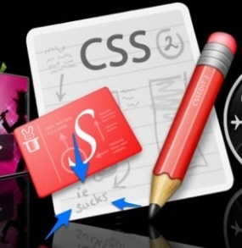

Web Fundamentals – Course Topics
HTML and CSS Overview – HTML basic tags, basic CSS, creating simple Web pages
HTML Structure – structural tags, header, footer, main, aside, tables, multimedia and other tags
CSS Selectors and Rules – basic CSS styling, CSS rules, selectors, pseudo-selectors, declaration, values…
CSS Presentation and Positioning – styling text borders, background, size, margins, positioning…
Creating Landing Pages

Slide 11

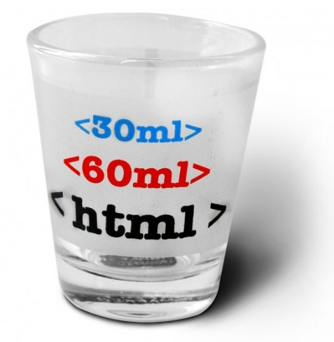
Web Fundamentals – Course Topics (2)
HTML Forms and Styling – HTML controls, styling forms
Responsive Design – media queries, flex grid, fonts tables...
Transitions and Animations – HTML5 transitions, HTML5 animations
Teamwork Public Defenses
Popular Libraries – Bootstrap, fonts, sliders, notifications, …
Exam Preparation
Practical Exam

Slide 12

The Trainers Team

Slide 13

Trainers Team
Svetlin Nakov, PhD
Training & Inspiration Manager @ Software University (SoftUni)
20+ years as software developer
10+ years experience as trainer
Author of 7 programming books
Speaker at hundreds of events
Winner in International programming contests and Olympiads
Web site & blog: www.nakov.com

Slide 14

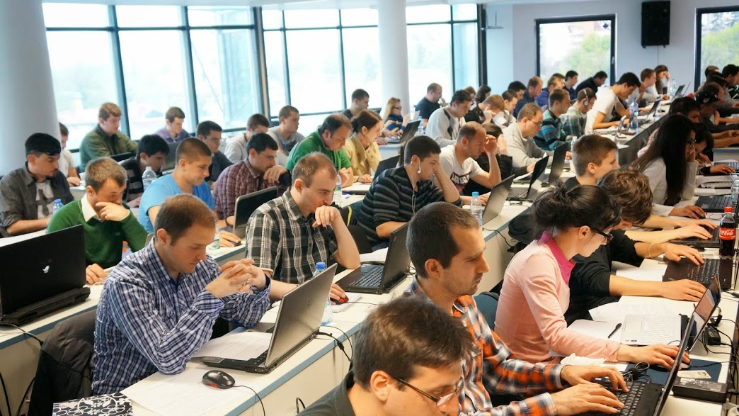
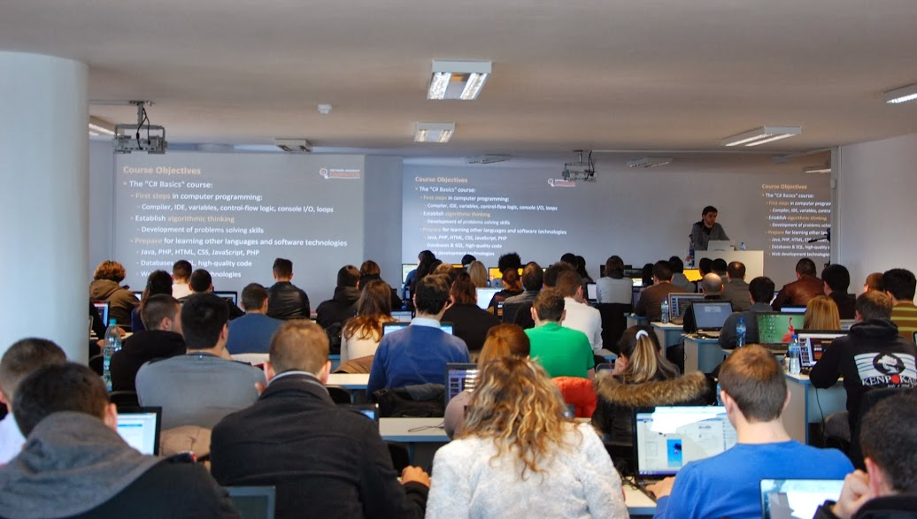
Teaching Assistants
Teaching assistants
Top students from SoftUni
Graduated the HTML course

Slide 15

Web Fundamentals: More Details
Duration, Languages, Technologies

Slide 16


Training Duration – Web Fundamentals
Lessons: ~ 20 hours (onsite + YouTube videos)
Practical exercises (in class): ~ 40 hours
Homework: ~ 20 hours
Exam preparation: 4 hours
Exam: 6 hours
Schedule: 25 Jan – 26 Mar 2017
Exam date: 26 March 2017

Slide 17

Why HTML & CSS?
HTML & CSS – standard for Web UI
Web-based applications are very popular
Runs on any device with a Web browser
HTML5 is currently the #1 job trend based on the fastest growing keywords found in online job postings
HTML5 takes bigger chunk of the mobile application market
Every IT professional should know HTML & CSS

Slide 18



Why English?
Why the slides are in English?
English is the native language of the software engineers
Specific terminology should be in English
Translations are inaccurate and funny
Just learn English!
No excuses

Slide 19
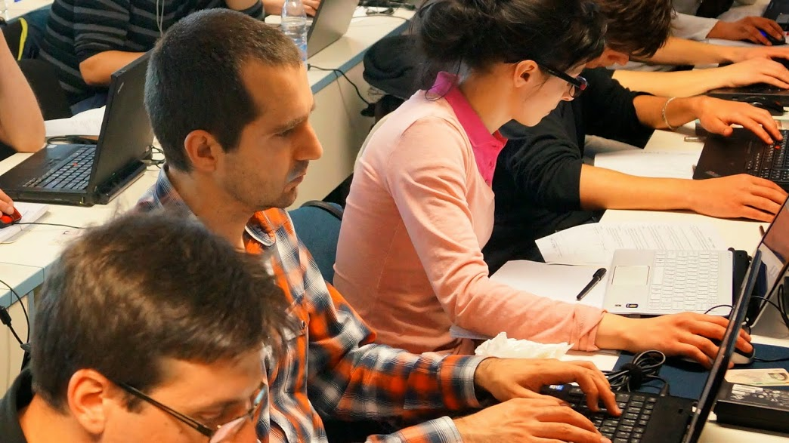


Web Fundamentals
Evaluation Criteria

Slide 20



Scoring System for the "Web Fundamentals"
Exam – 80%
Homework – 10%
Teamwork project – 10%
Forum activity – bonus up to 10%

Slide 21
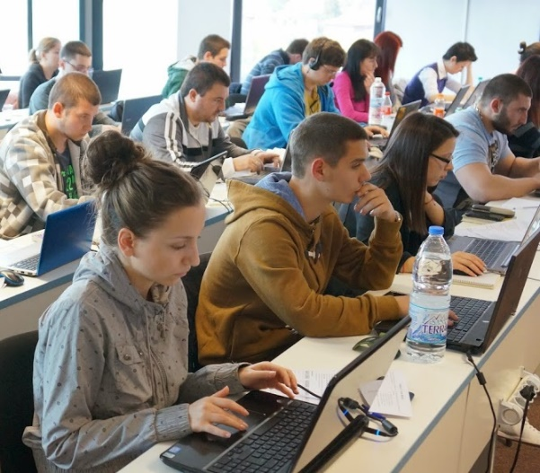

Web Fundamentals Exam
Practical HTML & CSS exam
4 practical problems for 6 hours
Slice a screenshot to HTML + CSS
Implement an HTML form (from screenshot to HTML + CSS)
Create a simple Web site from screenshot (header + menu + sidebar + footer)
Make a Web site responsive

Slide 22
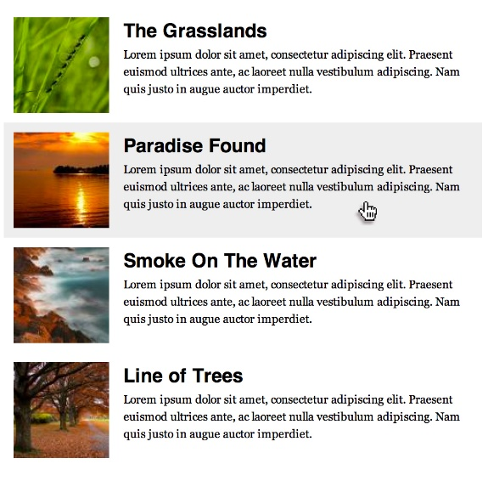


Sample Exam Problem
You are given a screenshot + set of images + texts
You should create the HTML & CSS to implement the page at the screenshot
+

Slide 23

Homework Assignments
Doing your homework is very important!
HTML and CSS can only be learned through a lot of practice!
You should write code every day!
Each lesson is followed by a few exercises
Try to solve them in class
The rest are your homework
Homework assignments are due in 5 days after each lesson
Submission are accepted through: judge.softuni.bg

Slide 24









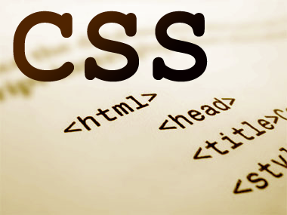
Resources
What We Need Additionally?

Slide 25

Course Web Site & Forums
The Web Fundamentals official course web site:
Join for the "Software University Forum":
Discuss the course exercises with your colleagues
Find solutions for all course exercises
Share source code / discuss ideas / help each other
https://softuni.bg/courses/web-fundamentals-html5
https://softuni.bg/forum/categories/68/web-basics

Slide 26
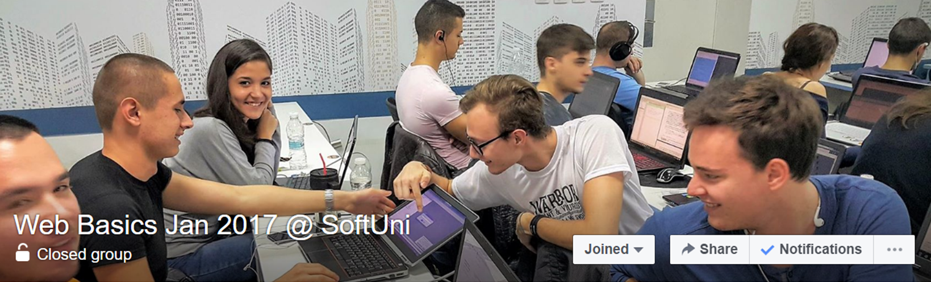
Facebook Group
The Web Fundamentals official Facebook group
facebook.com/groups/softuni.web.basics.jan.2017

Slide 27



Slides and Videos
All slides, videos, homework assignments, projects and other resources are open content, available for free
Visit the course web site to access the course resources

Slide 28

HTML & CSS Tutorials
W3School HTML Tutorial
http://www.w3schools.com/html/
Learn to Code HTML & CSS
http://learn.shayhowe.com/html-css/
CSS Tricks
http://css-tricks.com
Codecademy HTML & CSS Interactive Tutorials
https://www.codecademy.com/learn/learn-html-css

Slide 29

Software University Learning System (SULS)
Software University Learning System (SULS)
www.softuni.bg
Important resource for students
Homework submissions
Homework check-up
Exams and results
Reports about your progress
…

Slide 30



Recommended Software
You will need a good text editor, e.g.
Notepad++
You may try many HTML authoring tools like:
WebStorm
Visual Studio Code
Sublime Text / Atom / Brackets
Microsoft Visual Studio
Netbeans

Slide 31


Summary
The "Web Fundamentals" course teaches
The first steps in HTML & CSS
Training curriculum
HTML, tags, tables, forms, semantic HTML, CSS, styles, positioning, layout, responsive
Practical exam
4 practical problems for 6 hours
Learning resources
Slides, videos, software, books, forum
HTML & CSS

Slide 32
Web Fundamentals – Course Introduction
https://softuni.bg/courses/

Slide 33

License
This course (slides, examples, demos, videos, homework, etc.) is licensed under the "Creative Commons Attribution-NonCommercial-ShareAlike 4.0 International" license

Slide 34





Free Trainings @ Software University
Software University – High-Quality Education, Profession and Job for Software Developers
softuni.bg
Software University Foundation
softuni.org
Software University @ Facebook
facebook.com/SoftwareUniversity
Software University Forums
forum.softuni.bg

